Slide 1
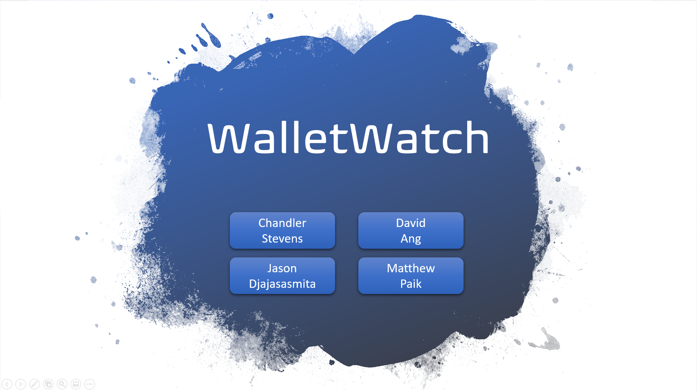

Slide 2

Who We Are
SpendSages:
Jason Djajasasmita
David Ang
Matthew Paik
Chandler Stevens
Computer Science majors at SPU

Slide 3
The Problem
Can be hard to stay accountable with spending
Can be difficult to remember where your money is going
Having personal finance info online comes with privacy concerns

Slide 4
Motivation & Inspiration
Eager to address the need of spending accountability
Ambitious to create a simple, fast, and securely offline solution
Highly interested in trying out Android mobile development

Slide 5

The Solution
WalletWatch
Self-discover your spending habits with a simple, secure, and offline app
Quickly add, view, edit, and delete expenses and view chart analytics
Free, open-source project hosted on GitHub
Available on the Google Play Store

Slide 6
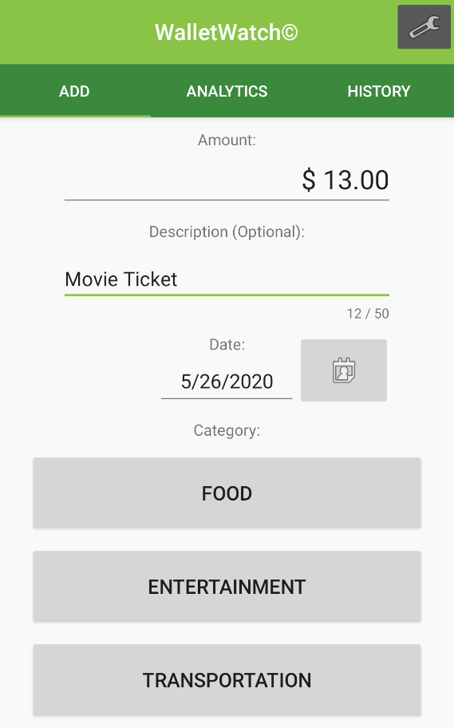
Adding Expenses
Quick & easy way to add an expense
Numpad displays on startup
Submit an expense in mere seconds

Slide 7
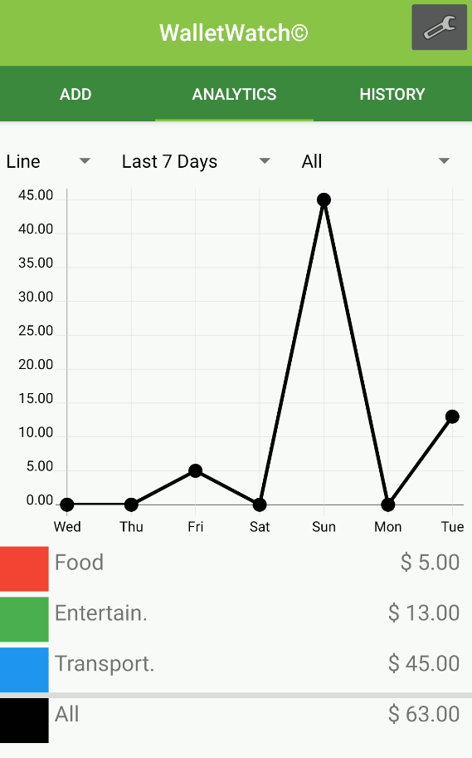
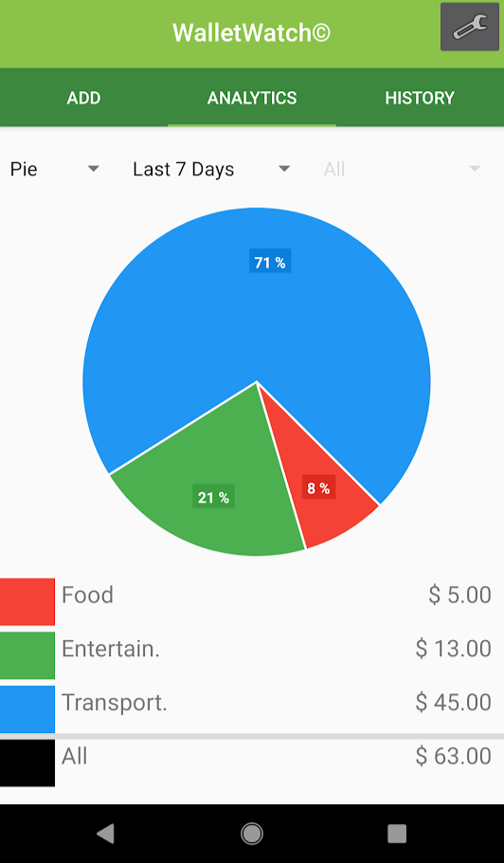
Analytics
Line & Pie charts at your fingertips
View your spending habits all in one place
Filter by time or category

Slide 8
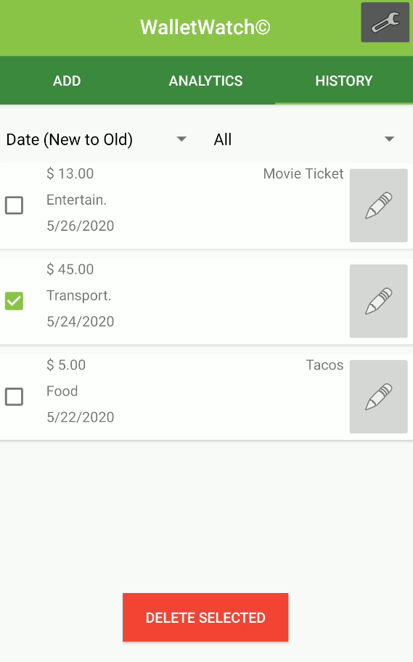
Expense History
Edit & delete previously submitted payments
Sort by date or price
Filter by category

Slide 9
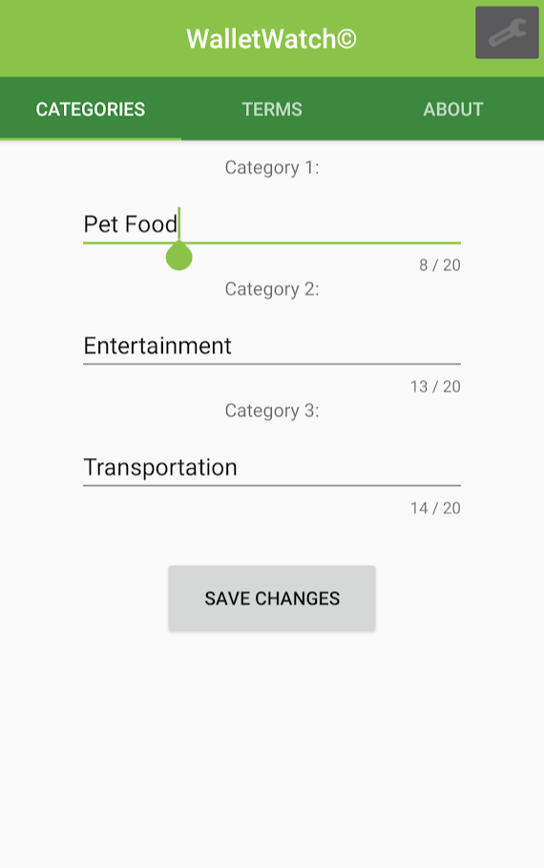
Edit Categories
Saves category data into archive
Allows tracking of new category
Restore archived category data

Slide 10
Got a Question?
Contact Us:
djajasasmitj@spu.edu
angd@spu.edu
stevensc3@spu.edu
paikm@spu.edu
GitHub:
https://github.com/thedavidang/CSC4151

